Slide 1
Designing Parallel Programs

Slide 2
Automatic vs. Manual Parallelization
Designing and developing parallel programs has characteristically been a very manual process. The programmer is typically responsible for both identifying and actually implementing parallelism.
Very often, manually developing parallel codes is a time consuming, complex, error-prone and iterative process.
For a number of years now, various tools have been available to assist the programmer with converting serial programs into parallel programs. The most common type of tool used to automatically parallelize a serial program is a parallelizing compiler or pre-processor.

Slide 3
A parallelizing compiler generally works in two different ways:
Fully Automatic
Programmer Directed
Programmer Directed
Using "compiler directives" or possibly compiler flags, the programmer explicitly tells the compiler how to parallelize the code.
Characteristically been a very manual process
Programmer’s responsibility.
The most common compiler generated parallelization is done using on-node shared memory and threads (such as OpenMP).

Slide 4
Fully Automatic
Various tools have been available to assist the programmer with converting serial programs and into parallel programs
If you are beginning with an existing serial code and have time or budget constraints, then automatic parallelization may be the answer. However, there are several important caveats that apply to automatic parallelization:
  Wrong results may be produced
  Performance may actually degrade
  Much less flexible than manual parallelization
  Limited to a subset (mostly loops) of code
  May actually not parallelize code if the compiler analysis suggests there are inhibitors or the code is too complex
The remainder of this section applies to the manual method of developing parallel codes.

Slide 5
Understand the Problem and the Program
Undoubtedly, the first step in developing parallel software is to first understand the problem that you wish to solve in parallel. If you are starting with a serial program, this means understanding the existing code also.
Before spending time in an attempt to develop a parallel solution for a problem, determine whether or not the problem is one that can actually be parallelized.
  Example of an easy-to-parallelize problem:
Calculation of the first 10,000 members of the Fibonacci series (0,1,1,2,3,5,8,13,21,...) by use of the formula:
F(n) = F(n-1) + F(n-2)
The calculation of the F(n) value uses those of both F(n-1) and F(n-2), which must be computed first.

Slide 6
Identify the program's hotspots:
  Know where most of the real work is being done. The majority of scientific and technical programs usually accomplish most of their work in a few places.
  Profilers and performance analysis tools can help here
  Focus on parallelizing the hotspots and ignore those sections of the program that account for little CPU usage.
Identify bottlenecks in the program:
  Are there areas that are disproportionately slow, or cause parallelizable work to halt or be deferred? For example, I/O is usually something that slows a program down.
  May be possible to restructure the program or use a different algorithm to reduce or eliminate unnecessary slow areas
Identify inhibitors to parallelism. One common class of inhibitor is data dependence, as demonstrated by the Fibonacci sequence above.
Investigate other algorithms if possible. This may be the single most important consideration when designing a parallel application.
Take advantage of optimized third party parallel software and highly optimized math libraries available from leading vendors (IBM's ESSL, Intel's MKL, AMD's AMCL, etc.).

Slide 7
Partitioning
One of the first steps in designing a parallel program is to break the problem into discrete "chunks" of work that can be distributed to multiple tasks. This is known as decomposition or partitioning.
There are two basic ways to partition computational work among parallel tasks:
  Domain decomposition
  Functional decomposition.

Slide 8
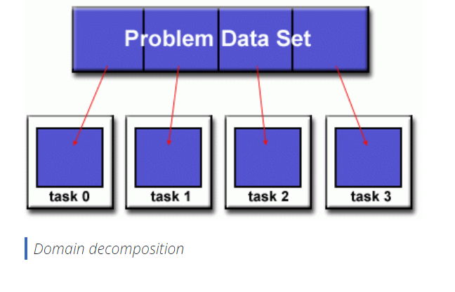
Domain decomposition
In this type of partitioning, the data associated with a problem is decomposed. Each parallel task then works on a portion of the data.

Slide 9
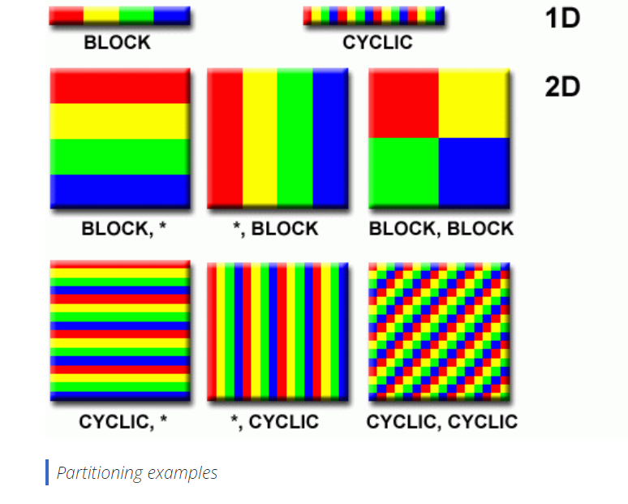
There are different ways to partition data:

Slide 10
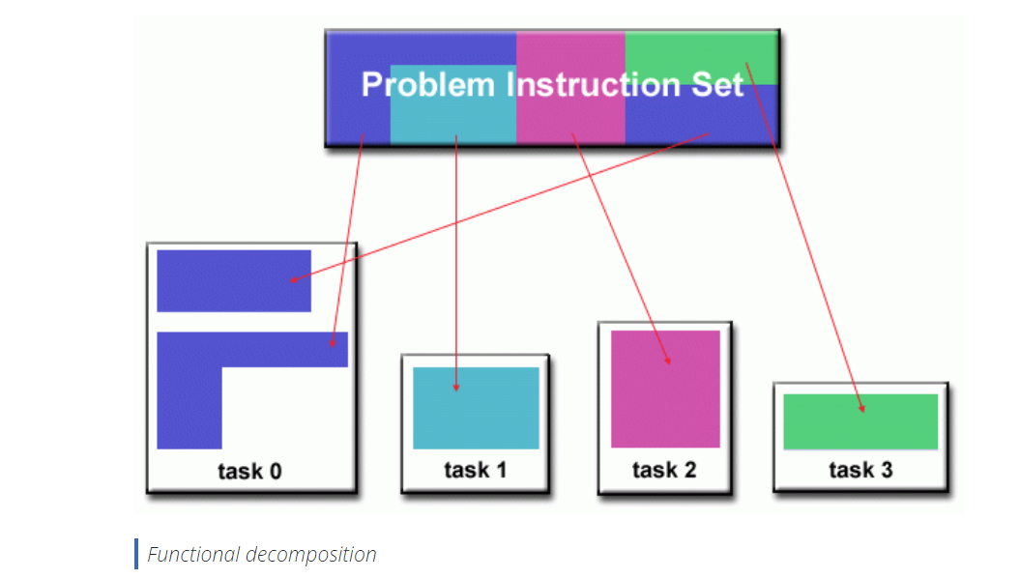
Functional Decomposition
In this approach, the focus is on the computation that is to be performed rather than on the data manipulated by the computation.
The problem is decomposed according to the work that must be done. Each task then performs a portion of the overall work.

Slide 11
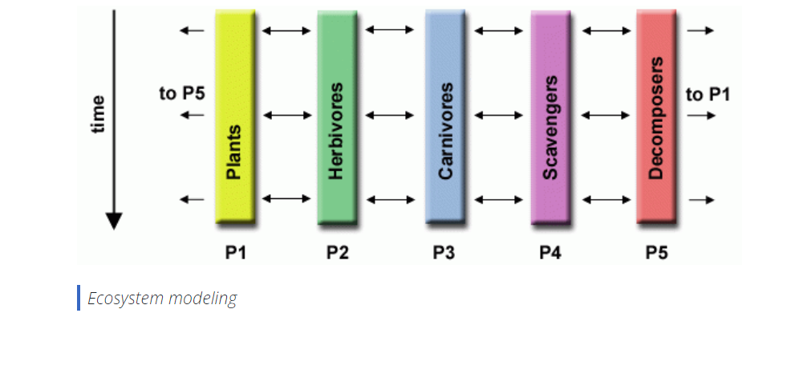
Ecosystem Modeling
Each program calculates the population of a given group, where each group's growth depends on that of its neighbors. As time progresses, each process calculates its current state, then exchanges information with the neighbor populations. All tasks then progress to calculate the state at the next time step.

Slide 12
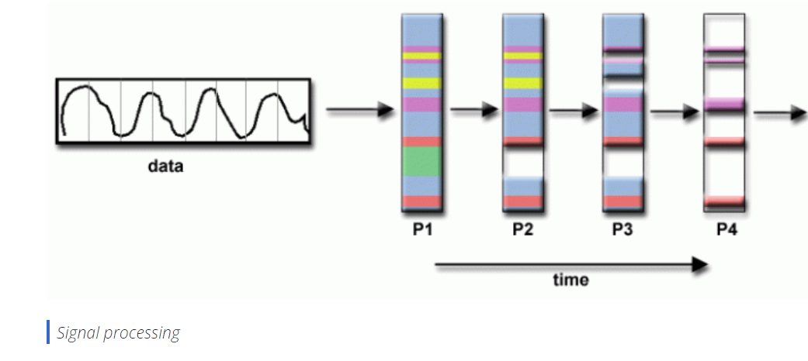
Signal Processing
An audio signal data set is passed through four distinct computational filters. Each filter is a separate process.
The first segment of data must pass through the first filter before progressing to the second.
When it does, the second segment of data passes through the first filter. By the time the fourth segment of data is in the first filter, all four tasks are busy.

Slide 13
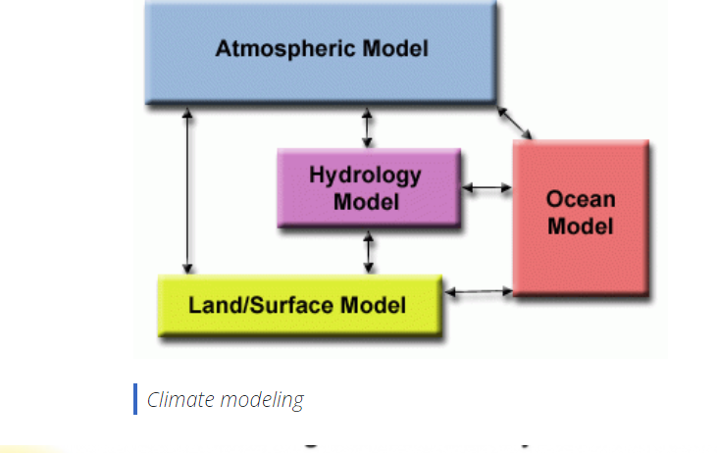
Climate Modelling
Each model component can be thought of as a separate task.
Arrows represent exchanges of data between components during computation: the atmosphere model generates wind velocity data that are used by the ocean model, the ocean model generates sea surface temperature data that are used by the atmosphere model, and so on.

Slide 14
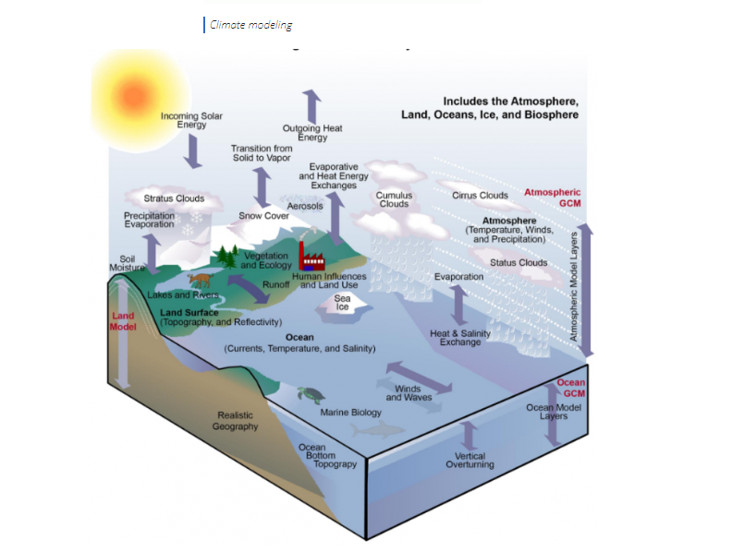
Combining these two types of problem decomposition is common and natural.

